Slide 1
亚历克上 - M202161029
Alec Mabhiza Chirawu
2021 - 2024
Communication Signal processing on a self-driving car with radar and a camera
-
information and communication department
-
ustb
From zimbabwe
Lecturer - 冯莉芳(Feng Lifang)

Slide 2
COMMUNICATION SIGNAL PROCESSING ON A SELF-DRIVING CAR WITH RADAR AND A CAMERA
Background?
Why Communication Signal Processing is useful ?
About the Projects -- Autonomous driving car.
Experiments 1 - Camera For Image processing
Pixel summation?
Formulars & Calculations?
Outputs?
Experiment 2 -- Radar
Radar detection and estimation.
Formulars & Calculations.
With and without guidance.
Signal directions
Estimation Kalma filtering
Comparison
Conclusion

Slide 3
Background
In 2021 i did lot of researches in Autonomous cars , looking at different aspects and methods of providing safe driving cars.
My graduation project was an image-processing-based autonomous self-driving automobile.
I subsequently met a friend through a game (PUBG) who was also interested in autonomous vehicles here in USTB, so we continued our research and looked at various options, such as employing radar.
Because all of the trajectories between the environment and the car must be calculated and the noise must be filtered to provide accurate information, communication signal processing became an important aspect of this project.

Slide 4
WHY COMMUNICATION SIGNAL PROCESSING IS USEFUL

Slide 5
Internet rely heavily on communication signal processing.
Radio.
Mobile phones.
Autonomous cars.
Telecomunication.
Automatic speech recognition.

Slide 6
MAIN 4 REASONS
STORAGE
sIGNAL Transmission speeds
Reduces the amount of space needed to store data.
Automobile moves from point A to B and to keep it in its track the signal beening transmitted by the intenna must be fast.
qUALITY
aCCURACY
Images have noise and it needs to be filtered to provide quality data.
Quality data provide then leads to the accuracy of our automobile movement form point A to B.

Slide 7
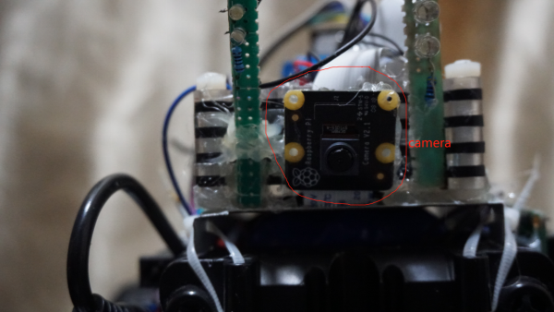
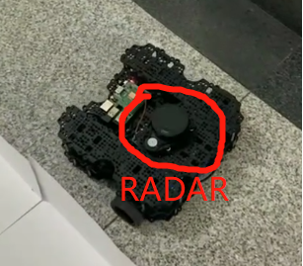
Experiments 1 & 2
Experiment 1 uses Image processing
Experiment 2 uses Radar

Slide 8
Experiment 1 --- Camera for image processing
Signal Processing: Image communication

Slide 9
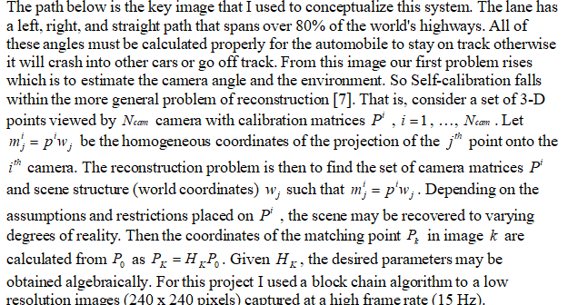
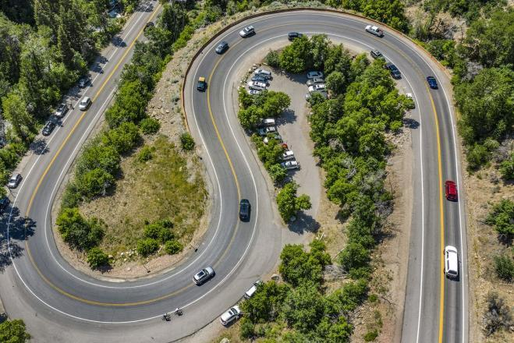
Pixel Summation

Slide 10
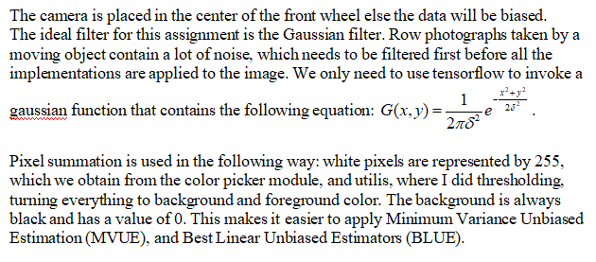

Slide 11
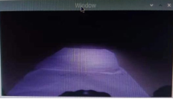
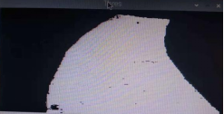
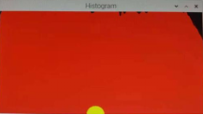
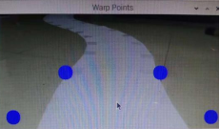
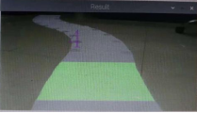
The outputs of detection and estimation | The path is captured as a white lane by the camera. The primary purpose of the window screen is to ensure that the car is in the correct position.
Threshold | Because the surrounding region has so many colors, it's difficult to deal with them all at once, thus the best option is to convert the RGB colors to a Gray imageand apply Gaussian filterwhich just comprises black and white (2 colors) and is simple to utilize.The white color represents the Lane that the autonomous vehicle must follow.
Histogram | The most efficient technique for the car to detect the midway point of the track is to use the Histogram.The algorithm, laneModule.py, and utilis.py module determine the width of the white lane on threshold and always keep track of the middle path of the path. The left and right distances of the lane will be calculated with the help of a matrix.The car detects the lane and uses the color code to determine which path is the primary one to take.
Wheel Points | Using a warping technique, the wheel pointsareestimated asdotted blue on the screen.Because I made all of the modules reusable, the warp aids in wheel alignment adjustments based on the car's kind and size.
The final screen output | I set the middle section of the curve to 0 and negative values as left curve and positive values as right curve for the algorithm to estimate if the curve is traveling left or right.The main aim is that the angle of the curve must remain at 0 , that means the car take turns providing good results.The car will follow the side with the most white values, as determined by the algorithm.

Slide 12
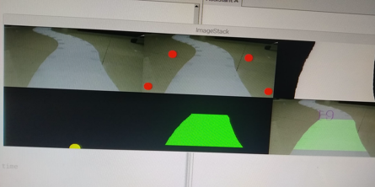
Outputs

Slide 13
Experiment 2 -- RADAR
Digitial signal processing.
more flexible

Slide 14
Radar detection and estimation
1.Data input: Copy radar scan, of any scan type short, medium or long.
2.Temporal alignment: Compute the elapsed time between radar scans and use it to sample ego motion module for the transformation matrix representing the change in position between radar scans.
3.Egomotion compensation: Use the transformation matrix to rotate and translate the tracked radar object’s state mean, error covariance estimate, and other properties.
4.Spatial alignment: Move the tracking origin from the vehicle coordinate system to the sensor coordinate system to allow proper prediction and data association.
5.Prediction: Estimate the new position and velocity of the tracked objects based on elapsed time between radar scans, as well as the estimation search region for track-to-detection data association.
6.Association: Probabilistically match incoming radar detections with current radar tracks.
7.Update: Use association scores to cluster detections to each track. From clusters update state estimates for position, velocity, acceleration, boundary, statistics and motion type (moving, stationary, stopped). Confirm tracks above certain quality metrics. Remove tracks below certain quality metrics.

Slide 15
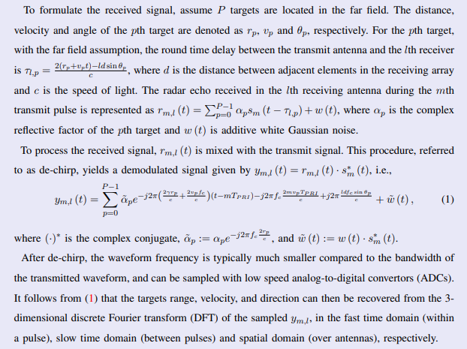
Formular and Calculations

Slide 16
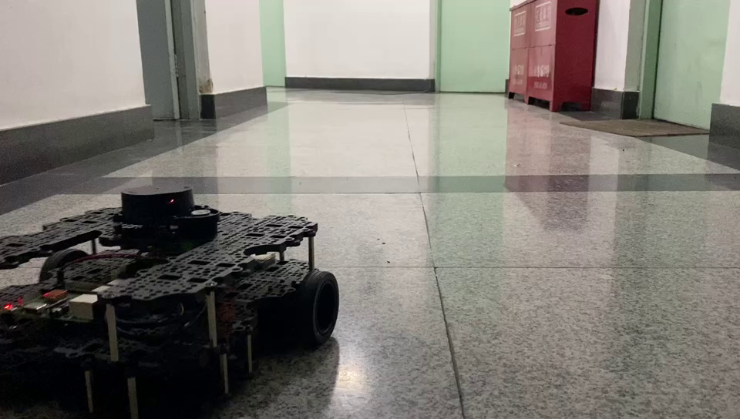
without guidance

Slide 17
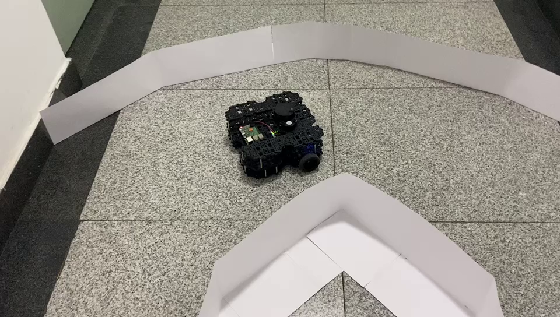
With guidance

Slide 18
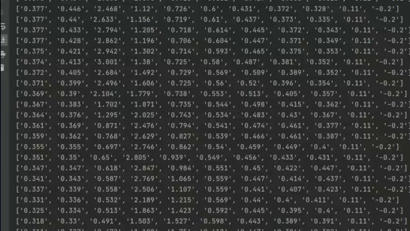
rADAR ARRAY OUTPUTS

Slide 19
a) Estimation Linear models
The antenna radiates electromagnetic energy which is represented in red and then it receives electromagnetic energy which is represented by green. The yellow rectangle shows the clear path. The Antenna receives the electromagnetic energy and then compare the values with those in the database and compare the distance . In the picture below it received the signals from short electromagnetic energy proving that the distance from the obstacle and the antenna is too close, so the car needs to move to the open space. Using Best Linear Unbiased Estimator which is under linear model with the formular:

Slide 20
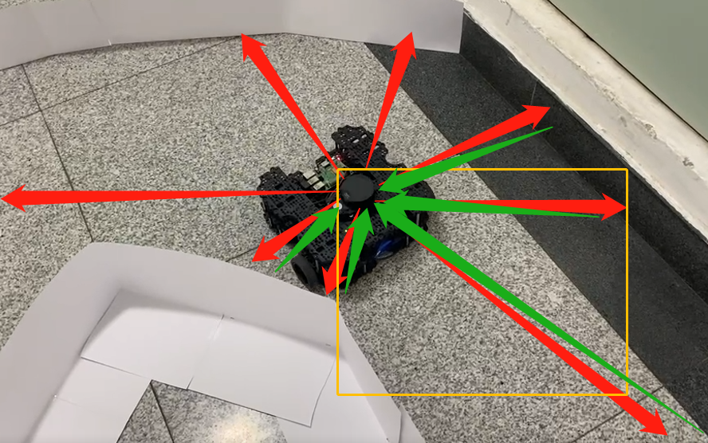
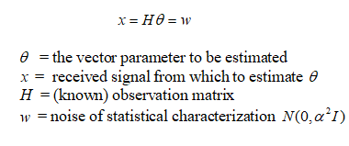
Signal directions (Send and Received)

Slide 21
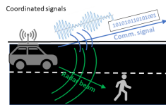
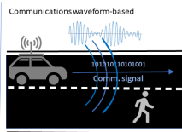
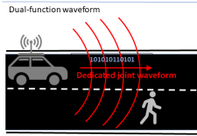
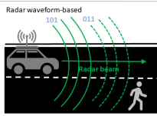

Slide 22
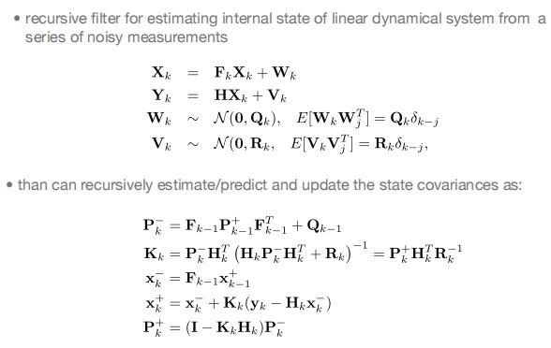
b)Estimation Kalman filtering
Kalman filtering is known as linear quadratic estimation(LQE), this algorithm uses a measurement observed over time which includes statistical noise and other inaccuracies and produces estimates of unknown variables that are more correct than Gaussian filtering which is based on a single measurement alone. It estimate joint probability distribution over the variables for each time frame.
Using this kalman filtering the car can calculate the distance from the antenna to the surrounding very fast that the car can keep its speed as well as avoiding obstacles. Using Tensorflow , we just call the kalman function which states that:

Slide 23
COMPARISON
Despite the fact that Kalman filters can be seen as a special case of Gaussian processes they differ in the way the models need to be thought about physical state- based versus covariance function that describe the underlying process.
Radar proved to be the best under the Kalman filter since the estimate variables of interest can’t be measured directly. Kalman filter proved so effective since the value provided by the radar were continuously changing. The great advantage of using Kalman filter are numbered including that Kalman is light on memory in the sense that it doesn’t keep any history other than the previous state which proved to be effective for the automobile. Due to the fact that it doesn’t keep history the speed is fast and that makes it suited for real time scenario as proven by the experiment.
Gaussian filtering, on the other hand, is more effective in image processing where noise and details must be removed. Gaussian reduces salt and pepper noise, which is commonly found in photos, and it is quite good at smoothing images. Due to the fact that lot of process needs to be done , Gaussian turns to be slow as compared to Kalman filtering in radar.

Slide 24
CONCLUSION
We've seen in this project that camera detection and distance estimation, as well as radar detection, function well. Image processing has the disadvantage of being able to focus on small areas, making it difficult to detect sharp turns and obstacles in the path. This problem is well solved by radar, which can detect obstacles all the way around but not potholes, which can be detected using the camera image processing method. All of the projects yielded positive results, and they were able to move from point A to point B under specific environmental conditions.
In image processing, Gaussian theory is superior for removing noise signals, but Kalman theory is better for noise filtering on radar because it utilizes a joint probability distribution that is fast when the radar is rotating 100 percent clockwise. Gaussian filtering performed well on images recorded by the camera and then compared to the dataset to determine the turning angle. Gaussian employs single value calculation, which takes a lengthy time if applied in radar.

Slide 25
亚历克上 - M202161029
THANK YOU !!!
CLASS OF THREE
PROFESSOr - 杜利平(Liping Du)

